Slide 1
Clustering Workshop
UNCC Association of Data Science

Slide 2
Overview
Introduction to Clustering
Understand the concept of clustering and its real-world applications.
Text Preprocessing Basics
Learn essential text preprocessing techniques to prepare data for analysis.
Dimensionality Reduction Techniques
Explore two powerful techniques for reducing high-dimensional data: PCA and t-SNE.
Clustering Algorithms
Dive into two popular clustering methods: K-means and Hierarchical Clustering.

Slide 3
Clustering
Clustering: A type of unsupervised machine learning technique that involves grouping similar data points together based on certain features or characteristics
Applications
Customer Segmentation: Businesses use clustering to group customers based on purchasing behavior, demographics, and preferences. This helps in targeted marketing and personalized product recommendations.
Healthcare and Disease Diagnosis: Clustering is used to analyze patient data and identify patterns in symptoms, disease progression, or genetic data. This assists in early diagnosis, treatment planning, and personalized healthcare.

Slide 4
Text Preprocessing
Why preprocess text?
Preprocessing helps standardize the format so machine learning algorithms can better understand and cluster the content.
Steps:
Lowercase Conversion
Remove Non-Alphabetic Characters
Remove Stopwords
Tokenization & Join

Slide 5
TF-IDF Vectorization
TF-IDF (Term Frequency–Inverse Document Frequency): It's a statistical method that transforms raw text into numerical values based on the importance of words in a document relative to the entire corpus.
How It Works:
Term Frequency (TF)
Measures how often a word appears in a document.
Example: If "data" appears 3 times in a doc with 100 words, TF = 3/100.
Inverse Document Frequency (IDF)
Measures how unique a word is across all documents.
Common words across many docs get lower scores (e.g., "the"), while rare words get higher scores.
TF × IDF = Final Score

Slide 6
PCA
PCA (Principal Component Analysis): a dimensionality reduction technique
Transforms high-dimensional data (like TF-IDF vectors) into fewer components that capture the most important variance in the data.
Why use PCA?
Reduces High-Dimensional TF-IDF Vectors – Condenses thousands of word dimensions into a smaller, more manageable space.
Enables 2D Visualization – Helps represent text data visually, making patterns and relationships clearer.
Reveals Document Similarities – Identifies how documents relate to each other based on word usage and meaning.

Slide 7
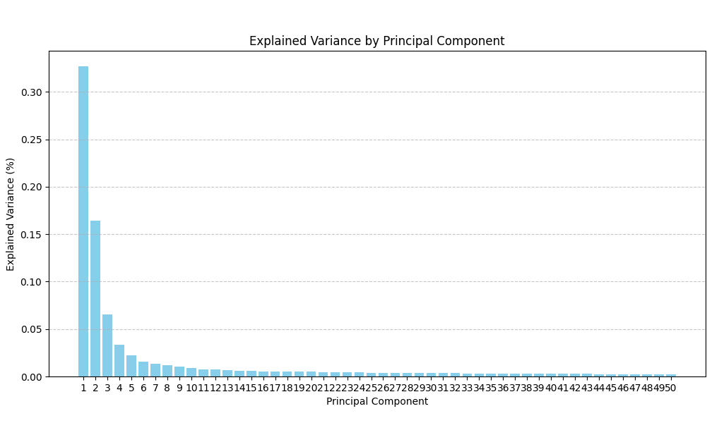
Visualizing PCA
Scree Plot: graphical representation used in principal component analysis (PCA) to visualize the variance explained by each principal component in a dataset.
Choose the number of components based on where the biggest drop occurs

Slide 8
t-SNE
t-SNE (t-Distributed Stochastic Neighbor Embedding): A non-linear dimensionality reduction algorithm that maps high-dimensional data to 2D or 3D space while preserving local structure.
Why use t-SNE?
Simplifies Complex Data – Reduces high-dimensional data to 2D or 3D, making visualization intuitive and presentation-friendly.
Reveals Hidden Patterns – Highlights natural clusters and relationships, ideal for customer segmentation, biological data, and word embeddings.
Enhances Interpretability – Provides a clear, non-linear representation of data structures that traditional methods might miss.

Slide 9
K-Means Clustering
K-Means Clustering: an unsupervised clustering algorithm that partitions data into K clusters based on feature similarity
How It Works:
Choose the number of clusters (K).
Initialize K centroids randomly.
Assign each data point to the nearest centroid.
Update centroids by computing the mean of assigned points.
Repeat until centroids stabilize.

Slide 10
Hierarchical Clustering
Hierarchical Clustering: builds a hierarchy of clusters without predefining K.
Dendrogram: A tree-like diagram that visualizes the clustering process and helps determine the optimal number of clusters.
Two Main Approaches:
Agglomerative: Bottom-up approach, starting with individual points and merging clusters.
Divisive: Top-down approach, starting with one large cluster and splitting recursively.

Slide 11
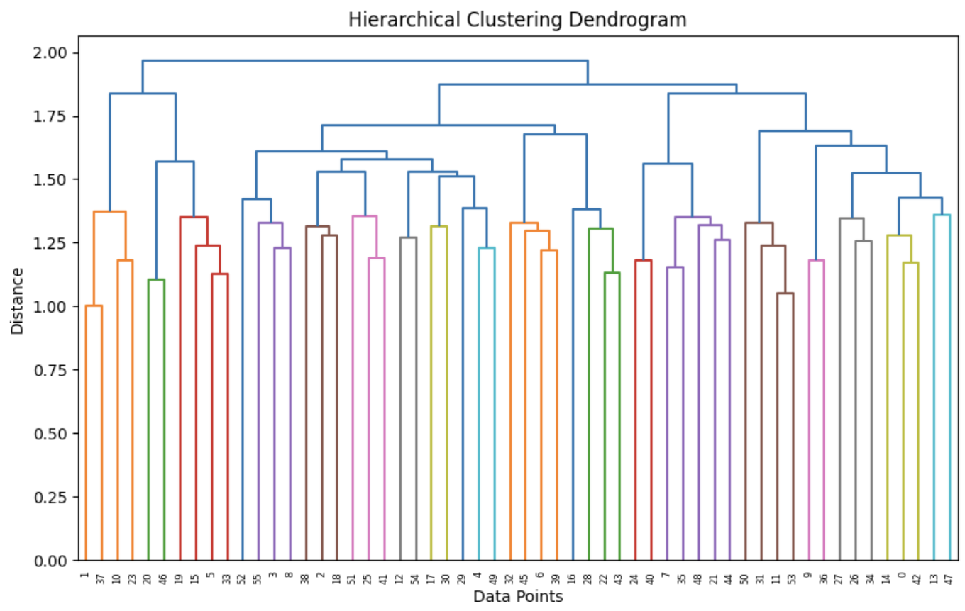
Hierarchical Clustering - Dendrogram

Slide 12
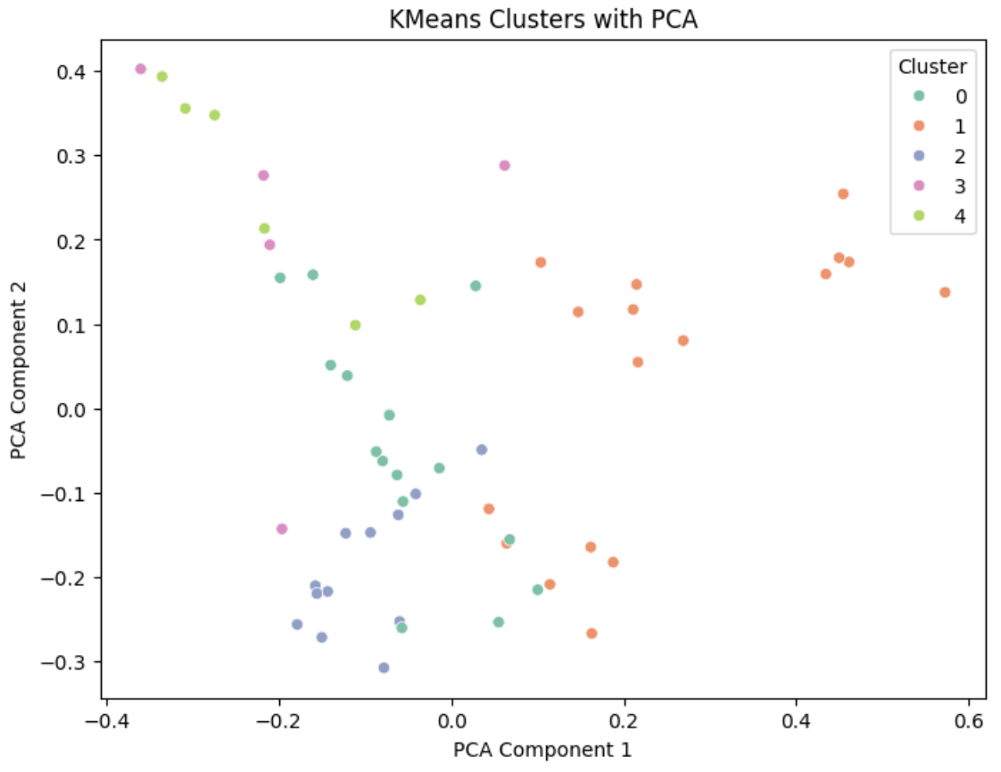
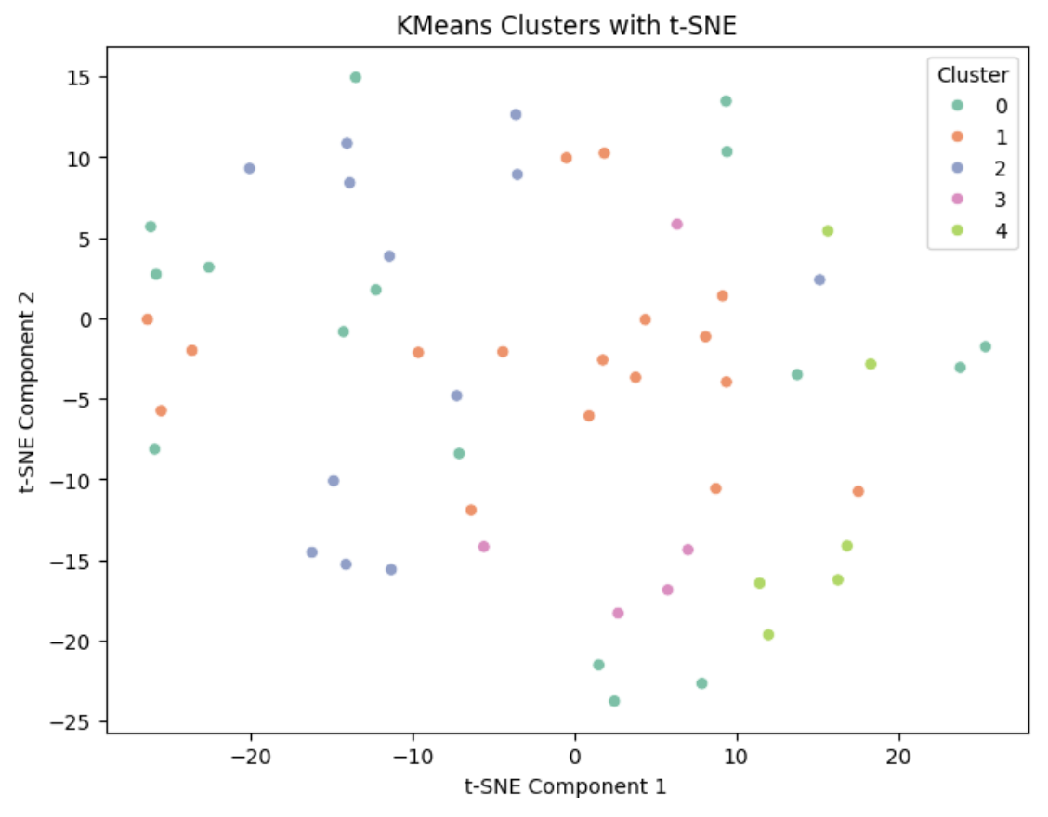
PCA vs t-SNE: K-Means

Slide 13
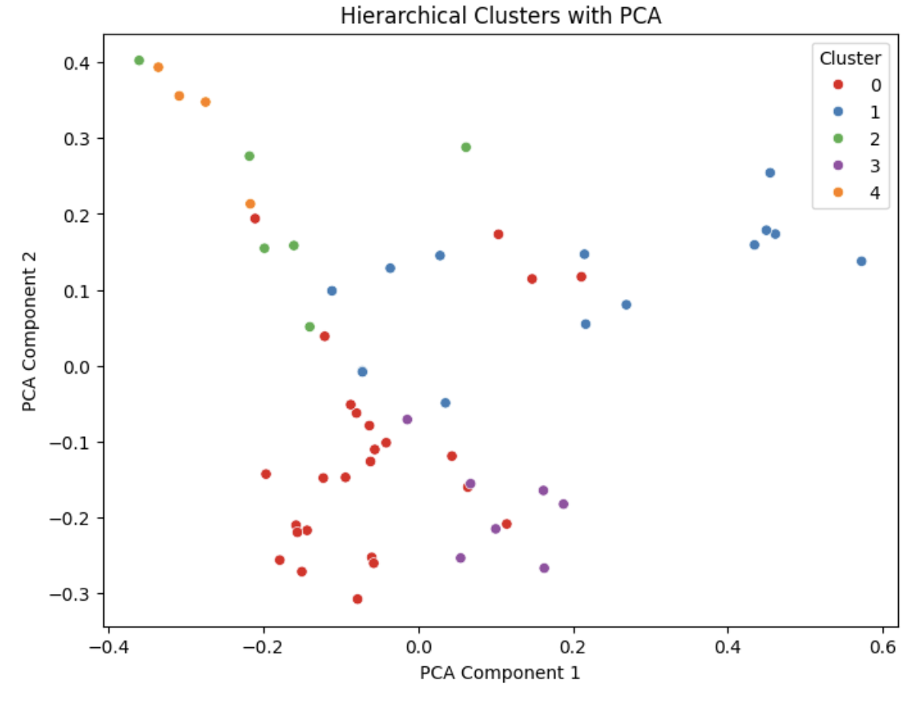
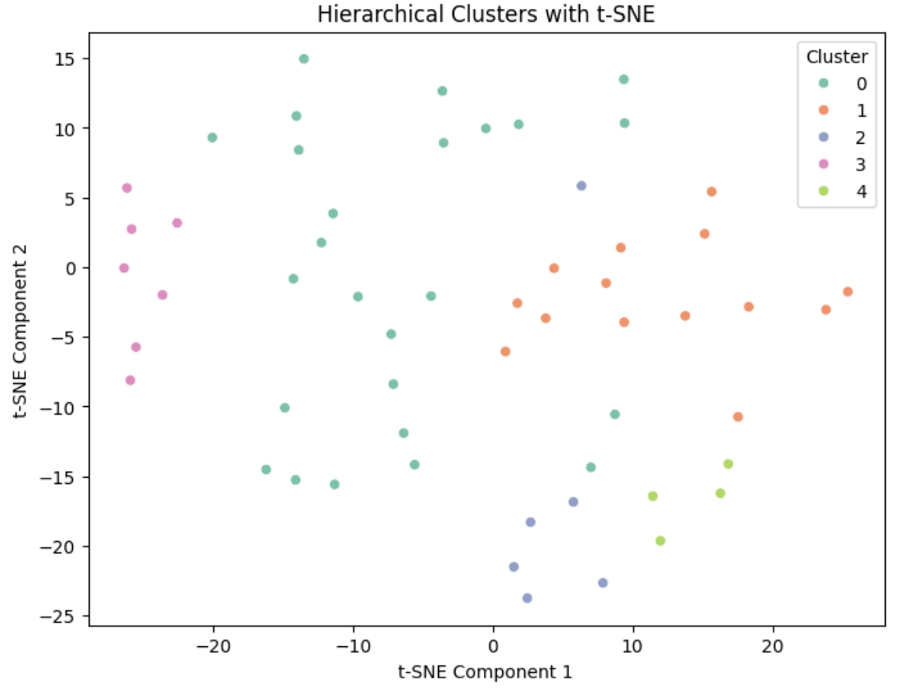
PCA vs t-SNE: Hierarchical

Slide 14
https://github.com/hannahbanjo/AssociationOfDataScience

